Slide 1
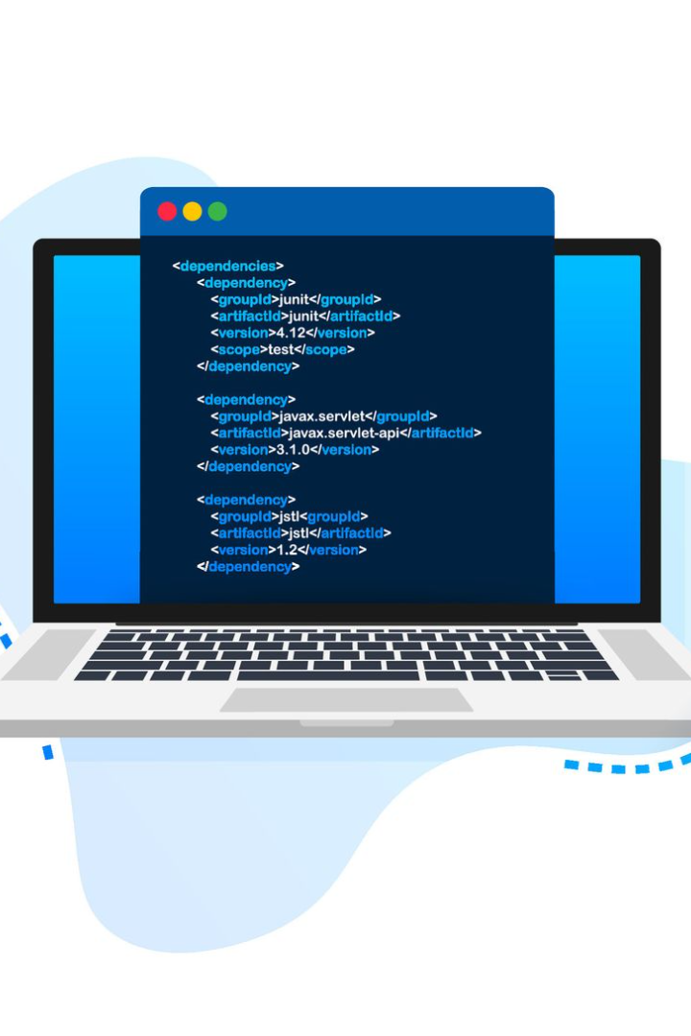
The Importance of a Compiler and IDE in Coding
Discover why a compiler and an Integrated Development Environment (IDE) are essential tools for developers, enhancing productivity and efficiency in coding.

Slide 2

Definition of a Compiler
A compiler is a software tool that translates high-level programming languages into machine code, enabling computers to execute the instructions.

Slide 3
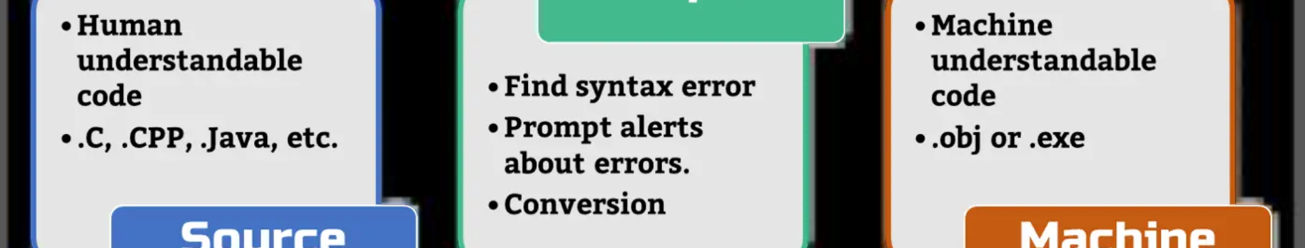
Role of a Compiler in the Coding Process
The compiler performs lexical analysis, syntax analysis, and semantic analysis, ensuring the code is error-free and translating it into executable machine code.

Slide 4
Benefits of Using an IDE
1
Efficient Coding Environment
2
Project Management
3
Version Control Integration
IDEs offer project organization tools, allowing developers to manage files, folders, and dependencies efficiently.
An IDE provides a comprehensive coding environment with features like auto-completion, syntax highlighting, and code debugging.
IDEs seamlessly integrate with version control systems, making it easier to track and manage code revisions.

Slide 5


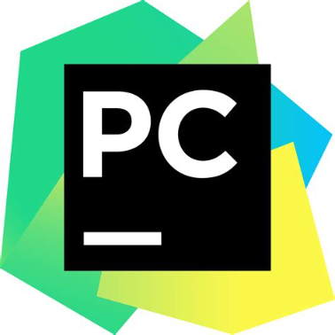
Features and Functionalities of Popular IDEs
Visual Studio Code
Eclipse
PyCharm
VS Code is known for its extensibility, code editing capabilities, and vast library of plugins.
Eclipse offers a rich set of features for Java development, including powerful debugging tools and a customizable user interface.
PyCharm provides intelligent code completion, code analysis, and a range of tools to support Python development.

Slide 6

How an IDE Enhances Productivity and Efficiency in Coding
1
Rapid Code Development
2
Error Detection and Correction
IDEs offer features like code snippets, templates, and intelligent suggestions, speeding up the coding process.
IDEs highlight syntax errors, undefined variables, and offer automated fixes, reducing debugging time.
3
Real-Time Collaboration
Modern IDEs enable developers to collaborate in real-time, making it easier to work on projects with distributed teams.

Slide 7
Common Challenges Faced Without an IDE
1
Manual Compilation
2
Code Organization
3
Limited Tools and Features
Without an IDE, developers need to manually compile and link their code, adding an extra step to the development process.
Managing code files and dependencies manually can lead to confusion and inefficiencies, especially in larger projects.
Working without an IDE restricts access to features like auto-completion, integrated debugging, and other productivity boosters.

Slide 8

Conclusion: Why a Compiler and IDE are Essential Tools for Developers
A compiler and IDE provide developers with the necessary tools and features to write, debug, and manage code efficiently, ultimately enhancing productivity and ensuring high-quality software development.

